Slide 1
Information Security
PUBLIC KEY Crypto
01
Reference book Information Security Principle & Practice

Slide 2
Date: 02/05/2021
02
Presented to:
Falguni Roy
Assistant Professor
IIT, NSTU
Presented By:
Naimur Rahman (ASH1925011M)
Abdullah Al Mamun (ASH1925026M)
Abdullah Alif (ASH1925009M)

Slide 3
03
Table of Contents
Introduction
Knapsack
RSA
Diffie-Hellman
Elliptic Curve Cryptography
ECC Diffie-Hellman
Public Key Notation
Public Key Infrastructure

Slide 4
Public Key Cryptography
It is uses two keys for encryption and decryption
A public key which may be known by anybody and can be used to encrypt message
A private key, known only to the
recipient, used to decrypt message.
It has six ingredient
Plain Text
Encryption Algorithm
Public and Private Keys
Cipher Text
Decryption Algorithm
04

Slide 5
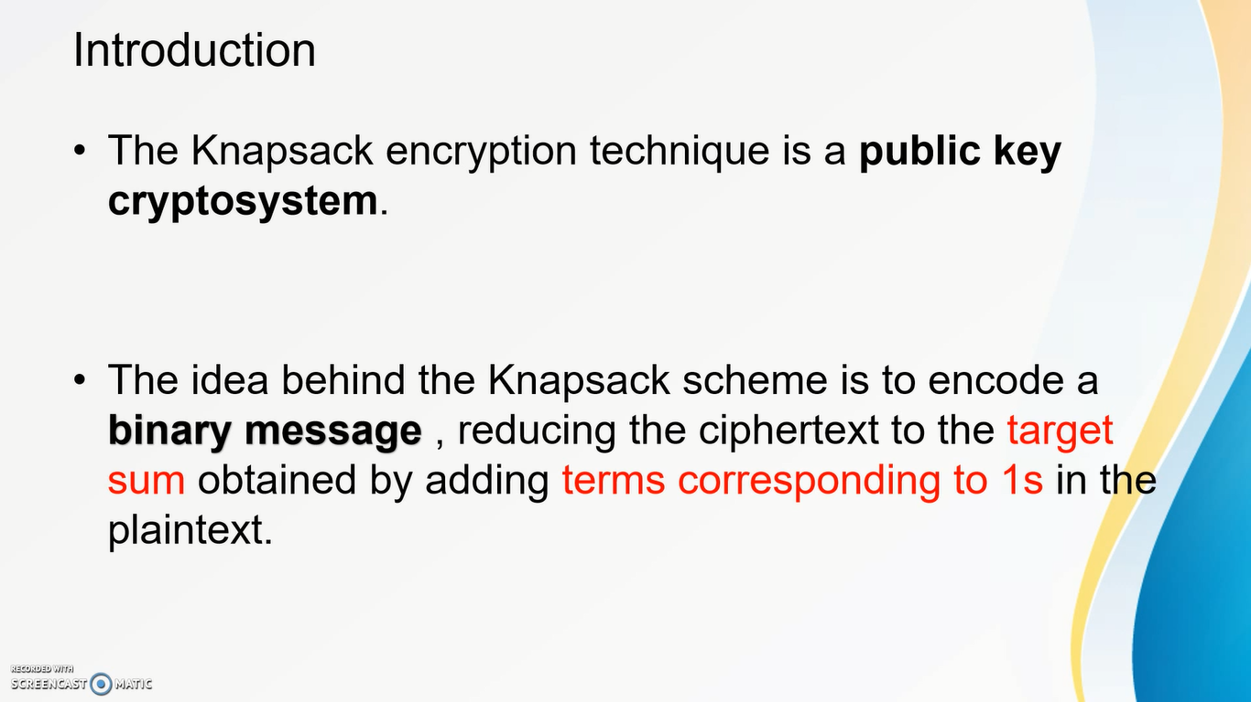
Knapsack
e>
05

Slide 6
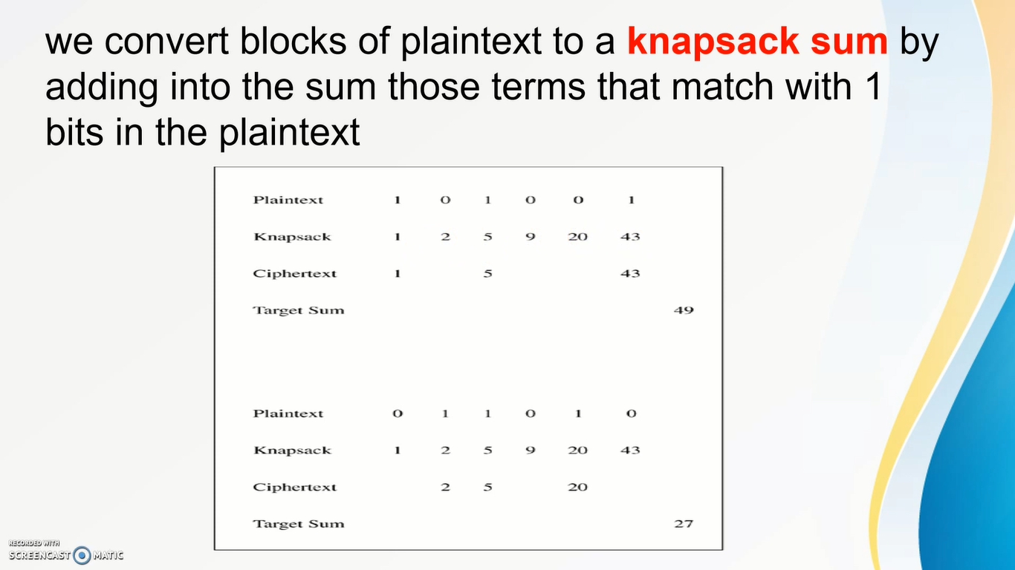
Knapsack
06

Slide 7
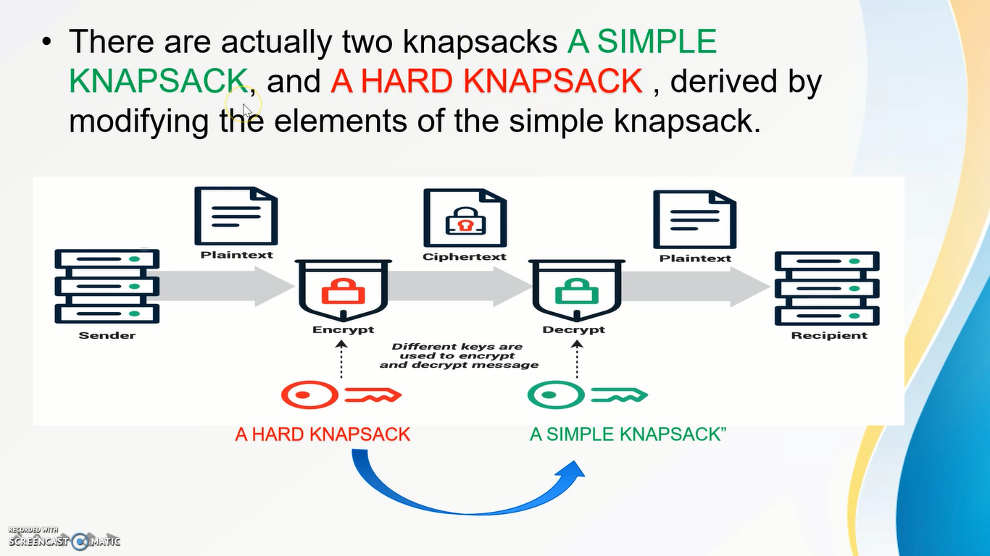
Knapsack
07

Slide 8
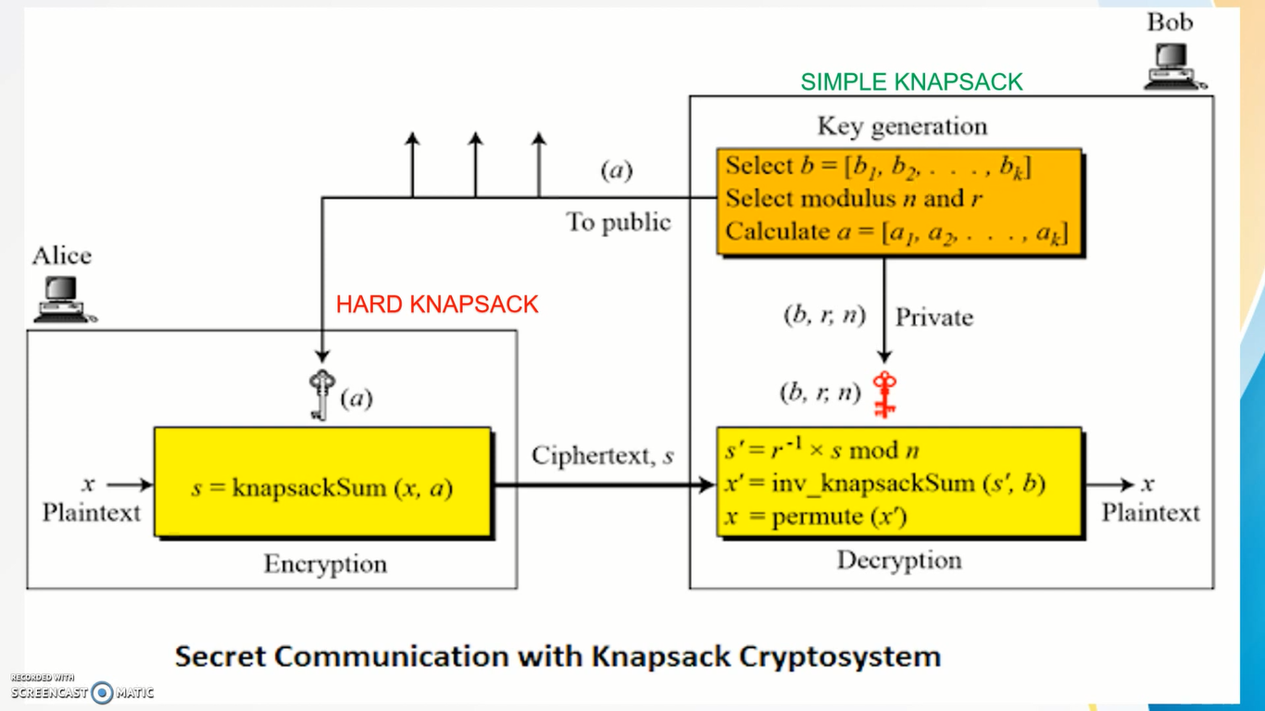
Knapsack
08

Slide 9
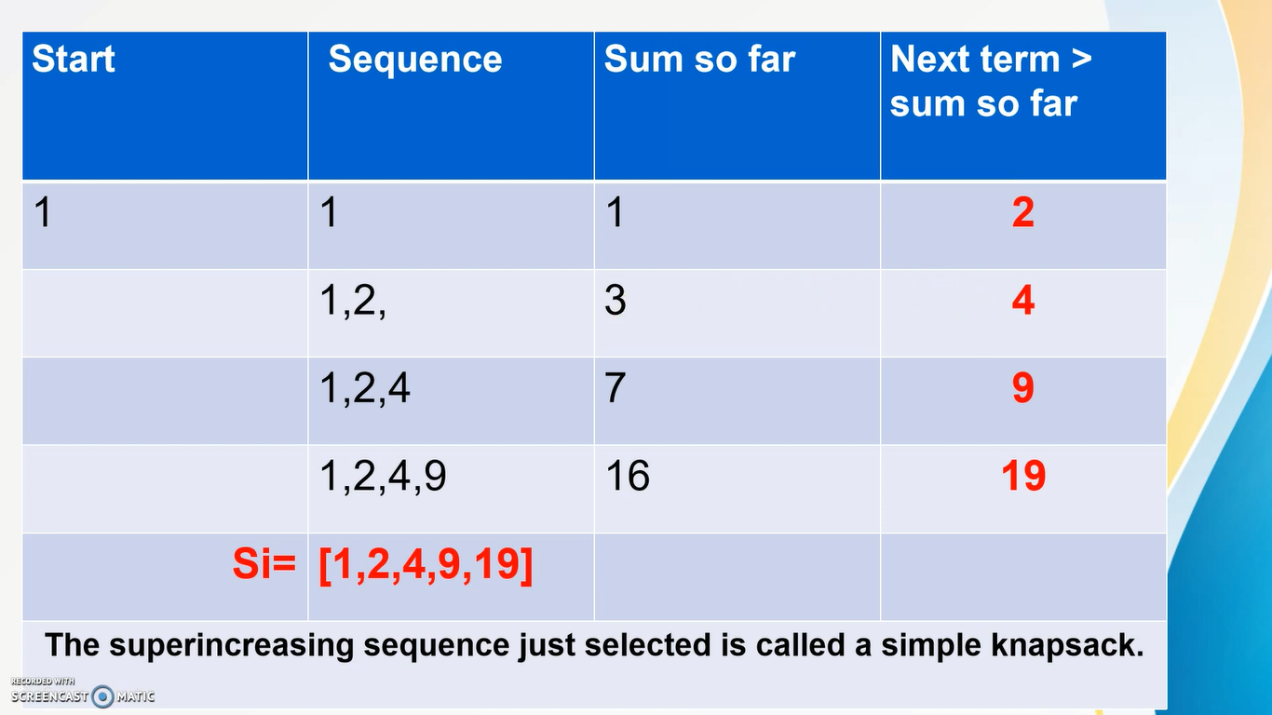
Knapsack
09

Slide 10
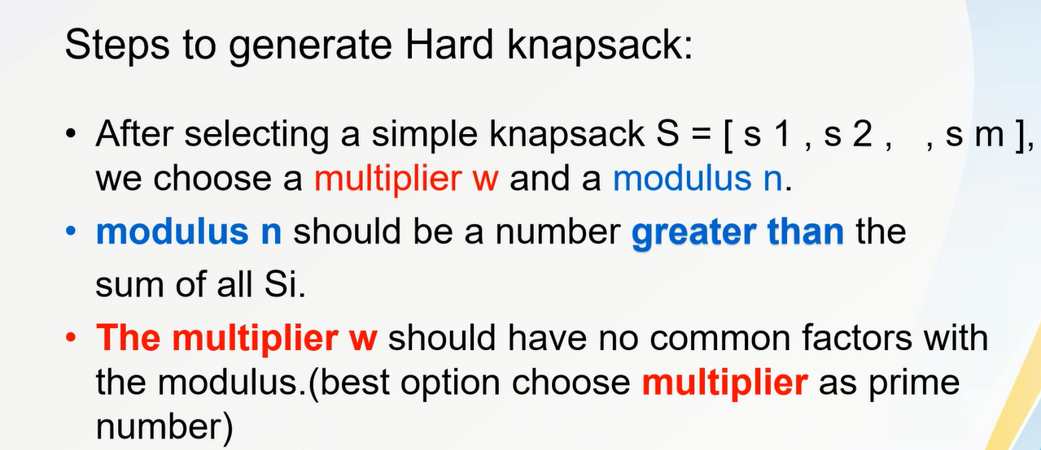
Knapsack
10

Slide 11
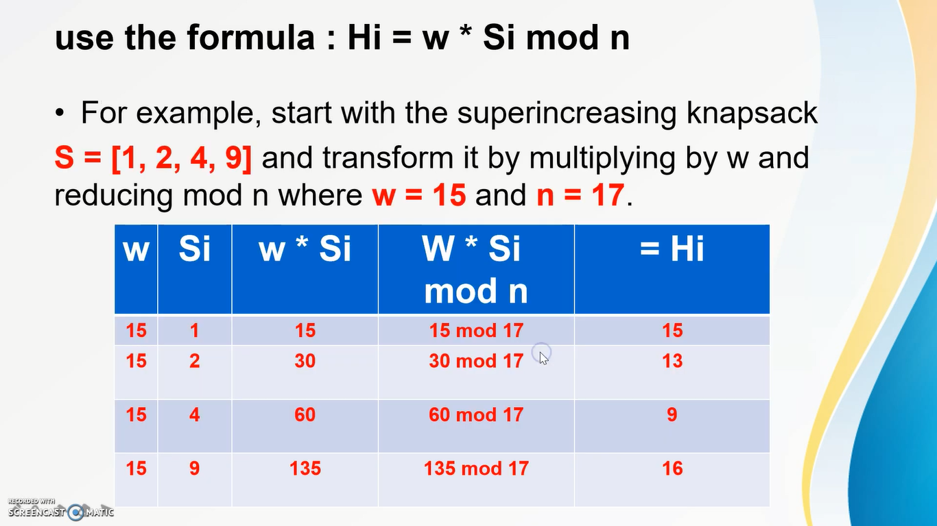
Knapsack
11

Slide 12
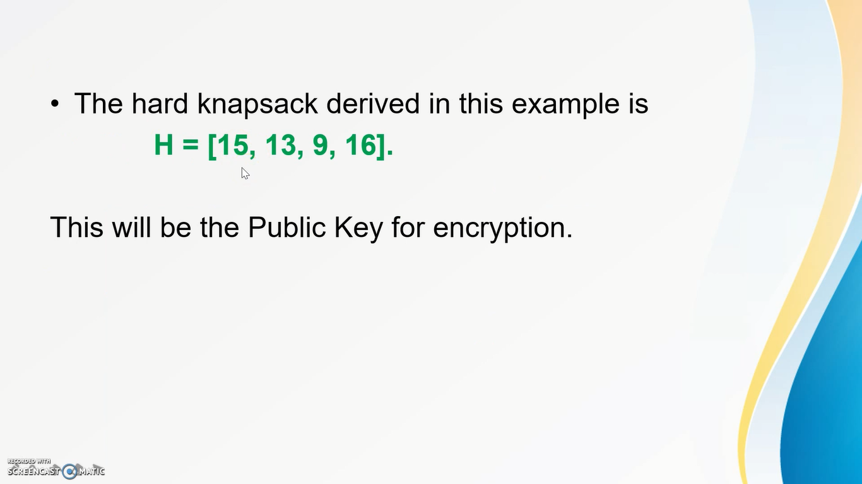
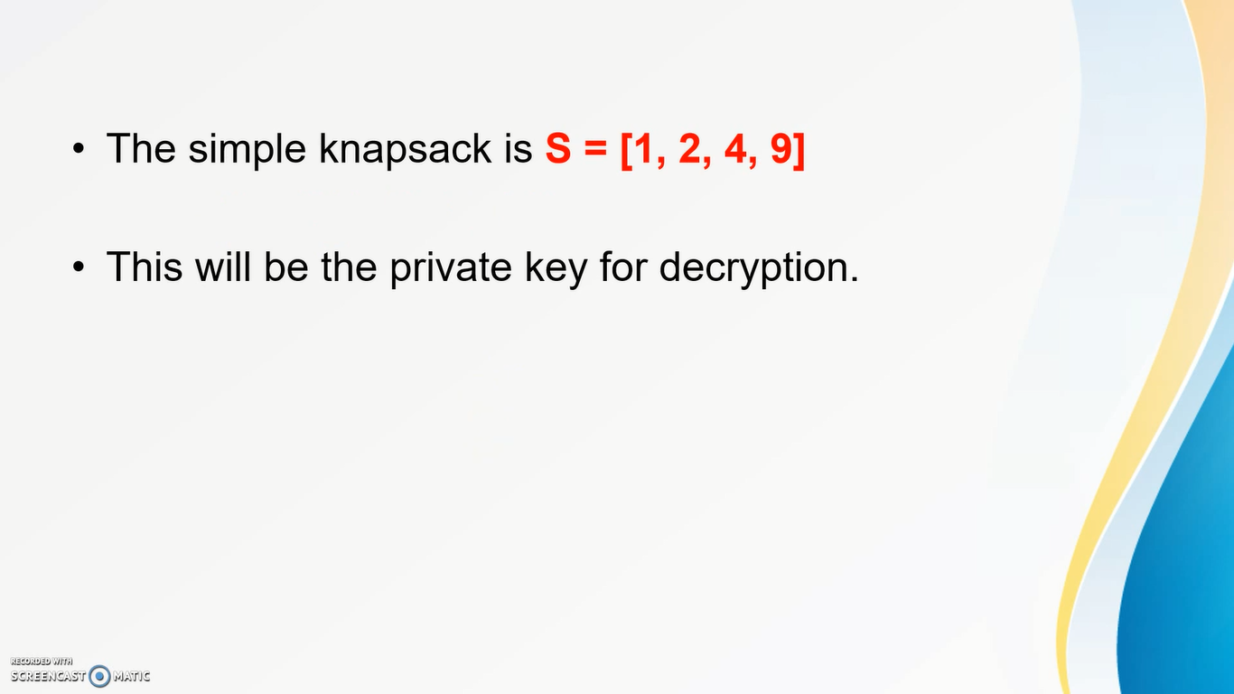
Knapsack
Public key for Encryption
12
Private key for Decryption

Slide 13
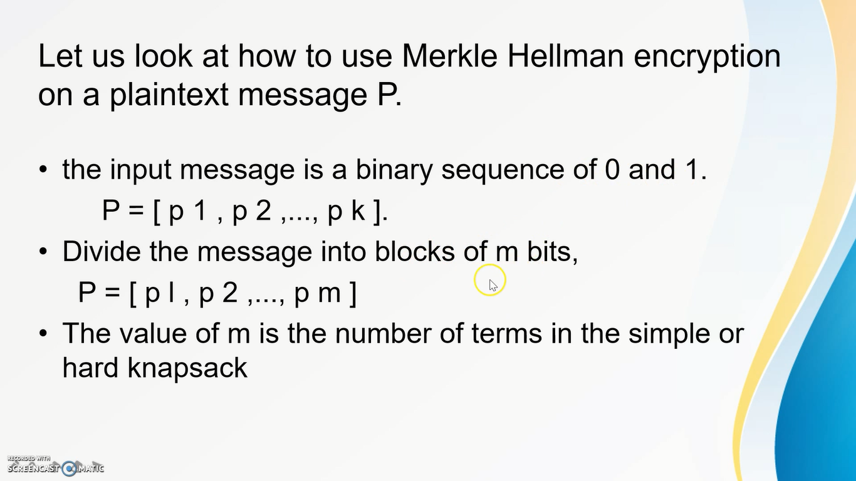
Knapsack
13

Slide 14
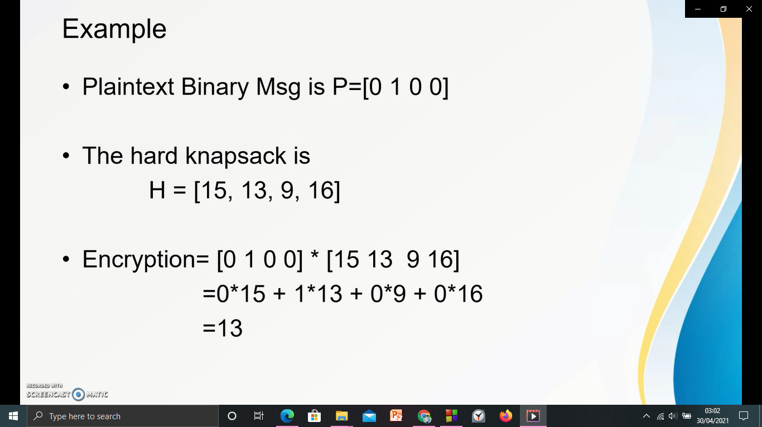
Knapsack
14

Slide 15
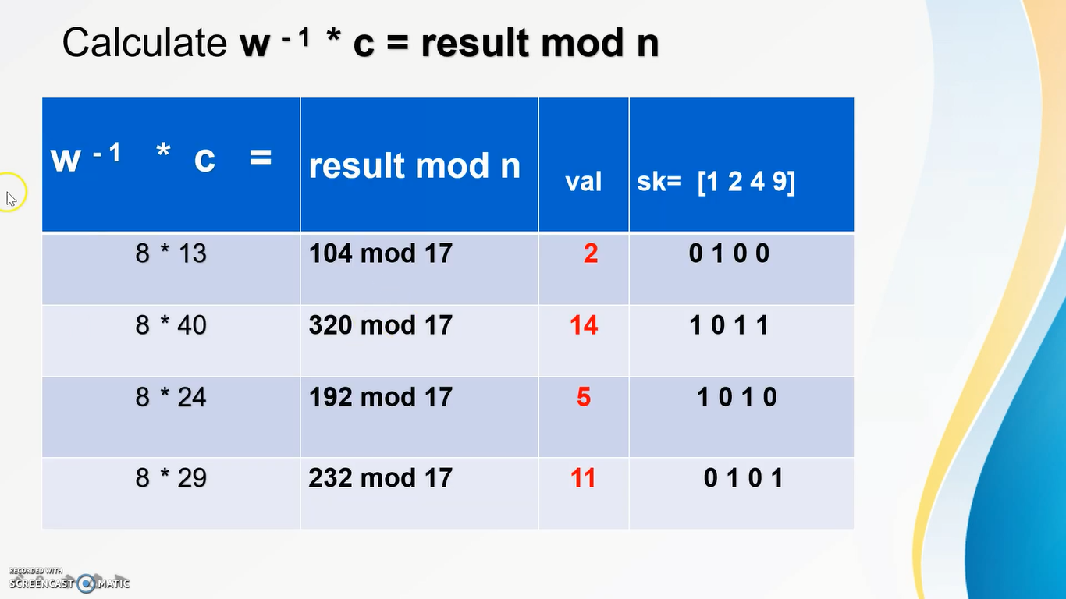
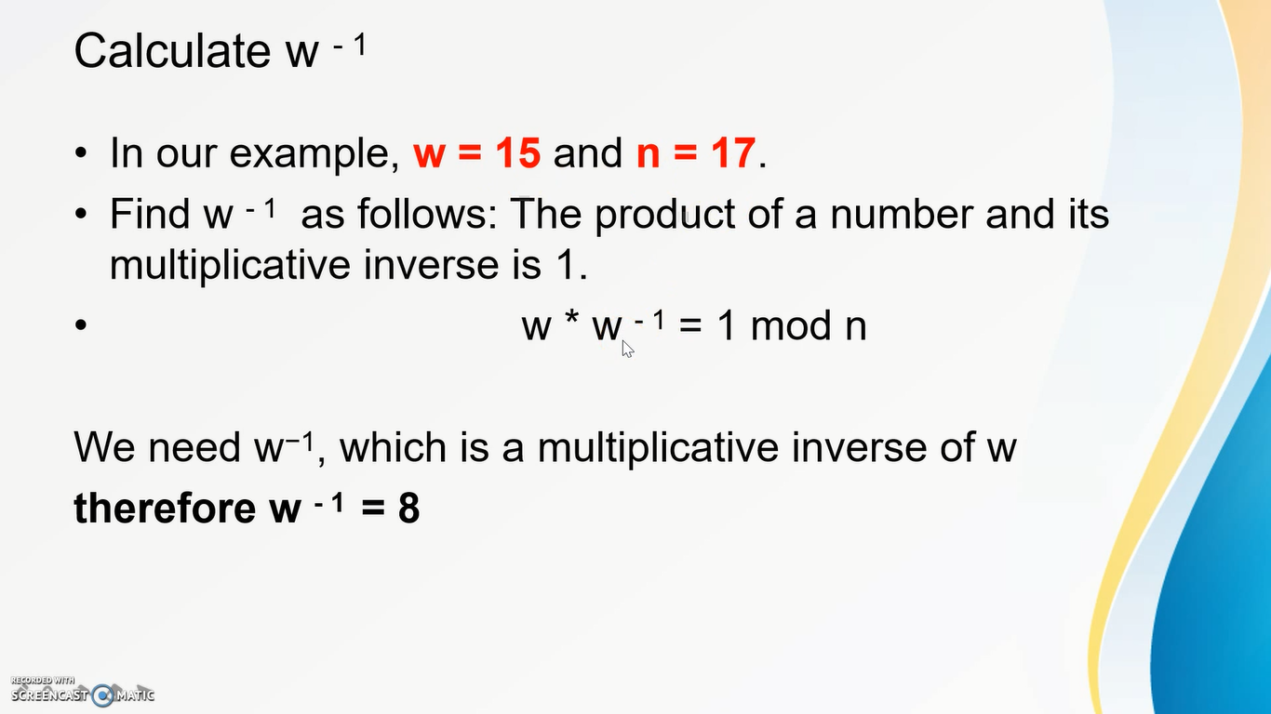
Knapsnack
Formula for Decryption
15
w=15 n=17
C= Cipher Text
Before Decryption

Slide 16
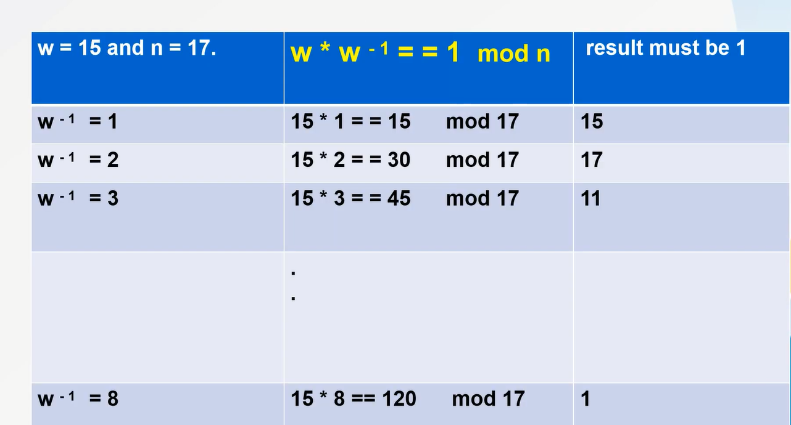
Knapsack
16

Slide 17
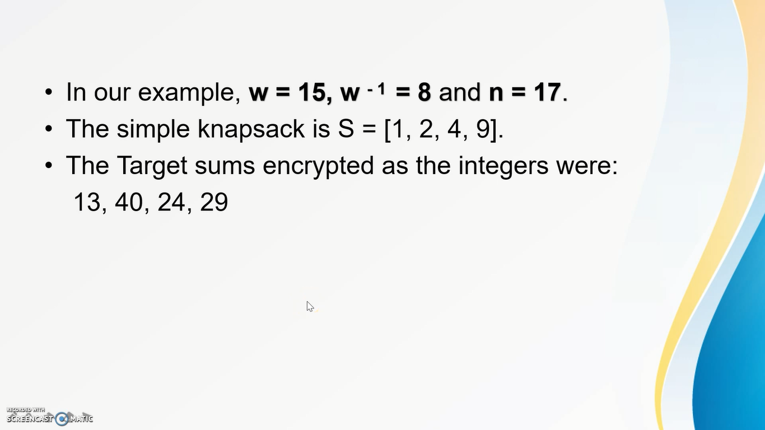
1 2 4 9
0 + 2 + 0 + 0 = 2
0 1 0 0
1 2 4 9
1 + 0 + 4 + 9 = 14
1 0 1 1
1 2 4 9
1 + 0 + 4 + 0= 5
1 0 1 0
1 2 4 9
0 + 2 + 0 + 9= 11
0 1 0 1
17

Slide 18
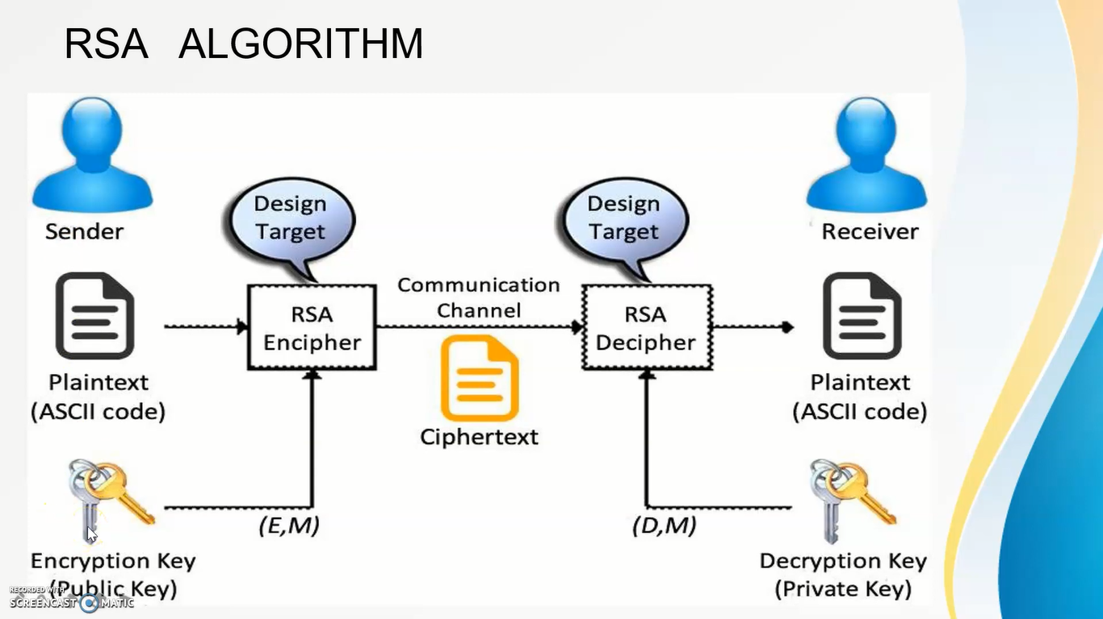
RSA Algorithm
18

Slide 19
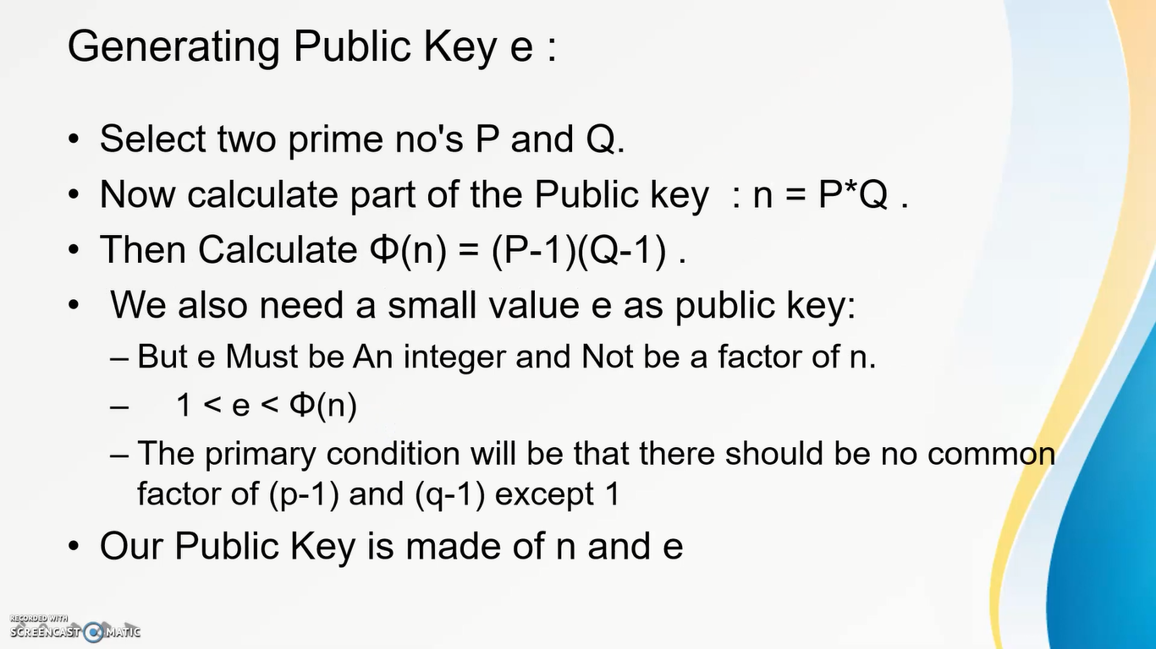
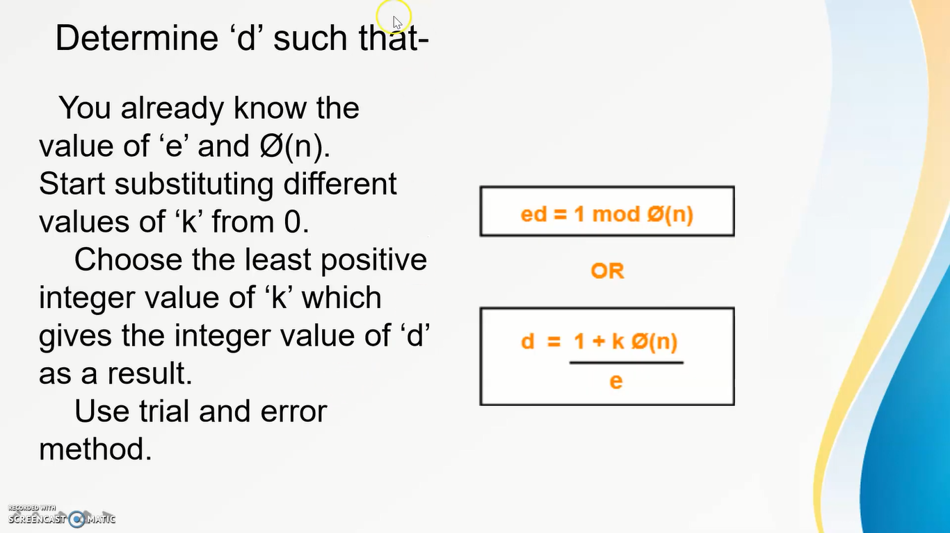
Generating Public Key(e)
19
Formula for getting Private Key(d)

Slide 20
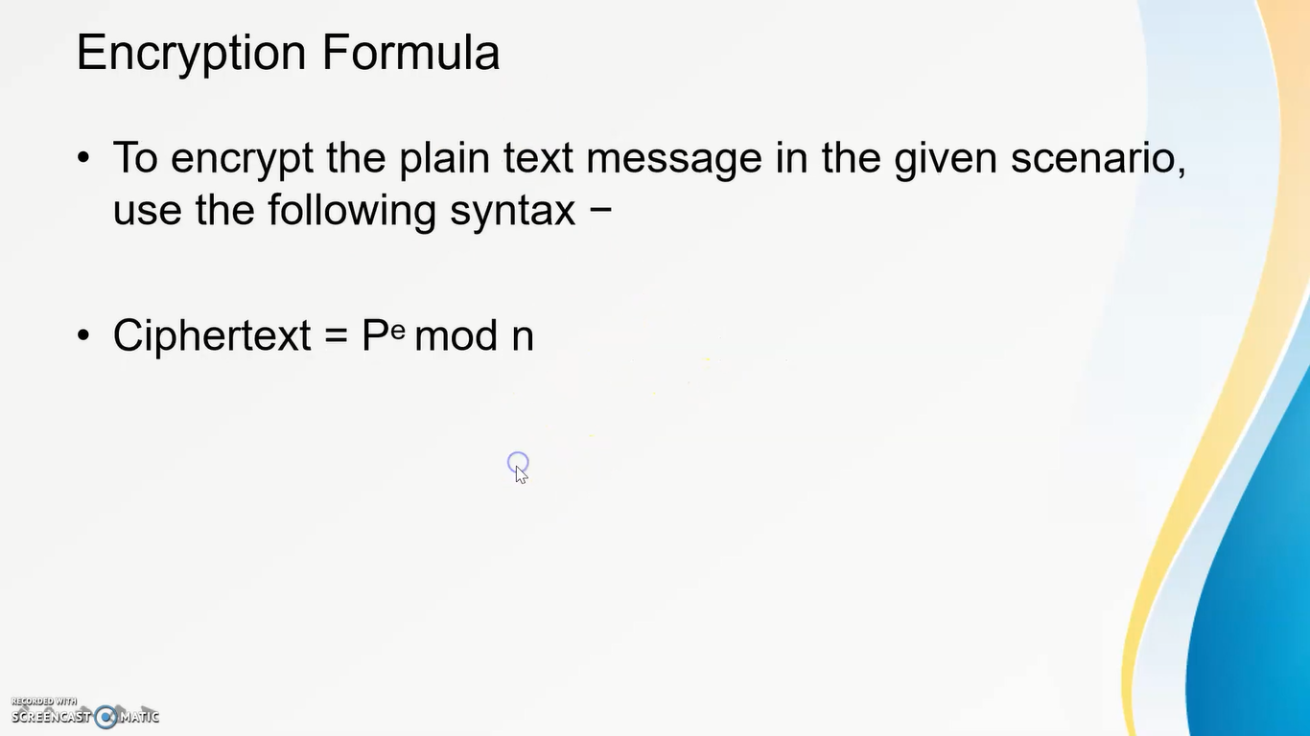
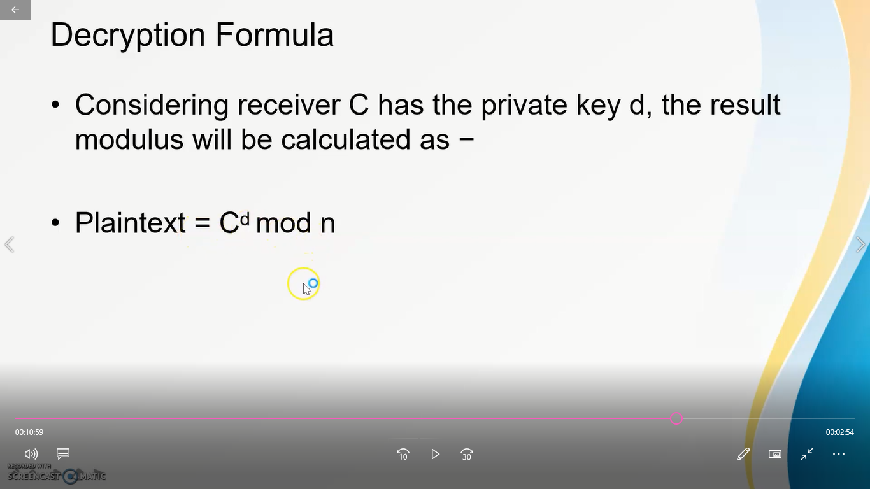
RSA
20

Slide 21
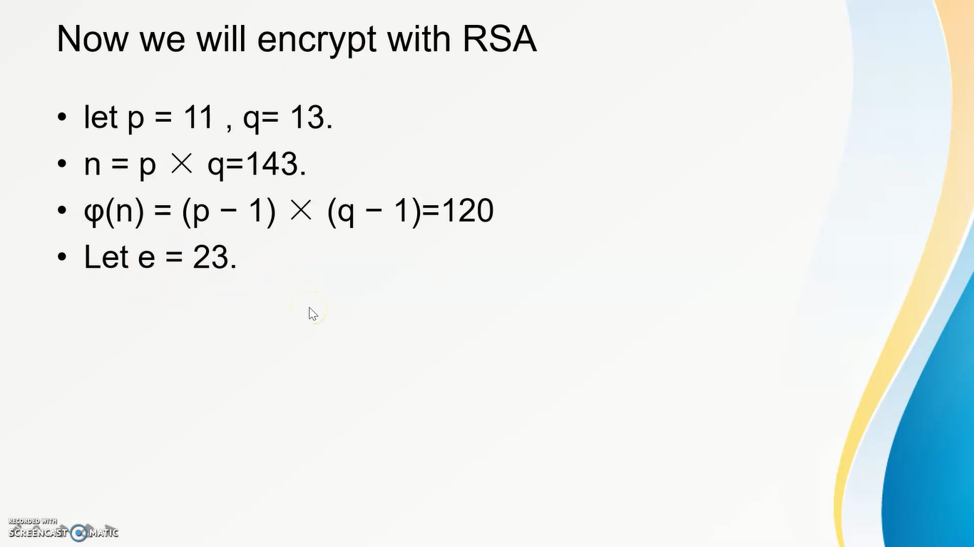
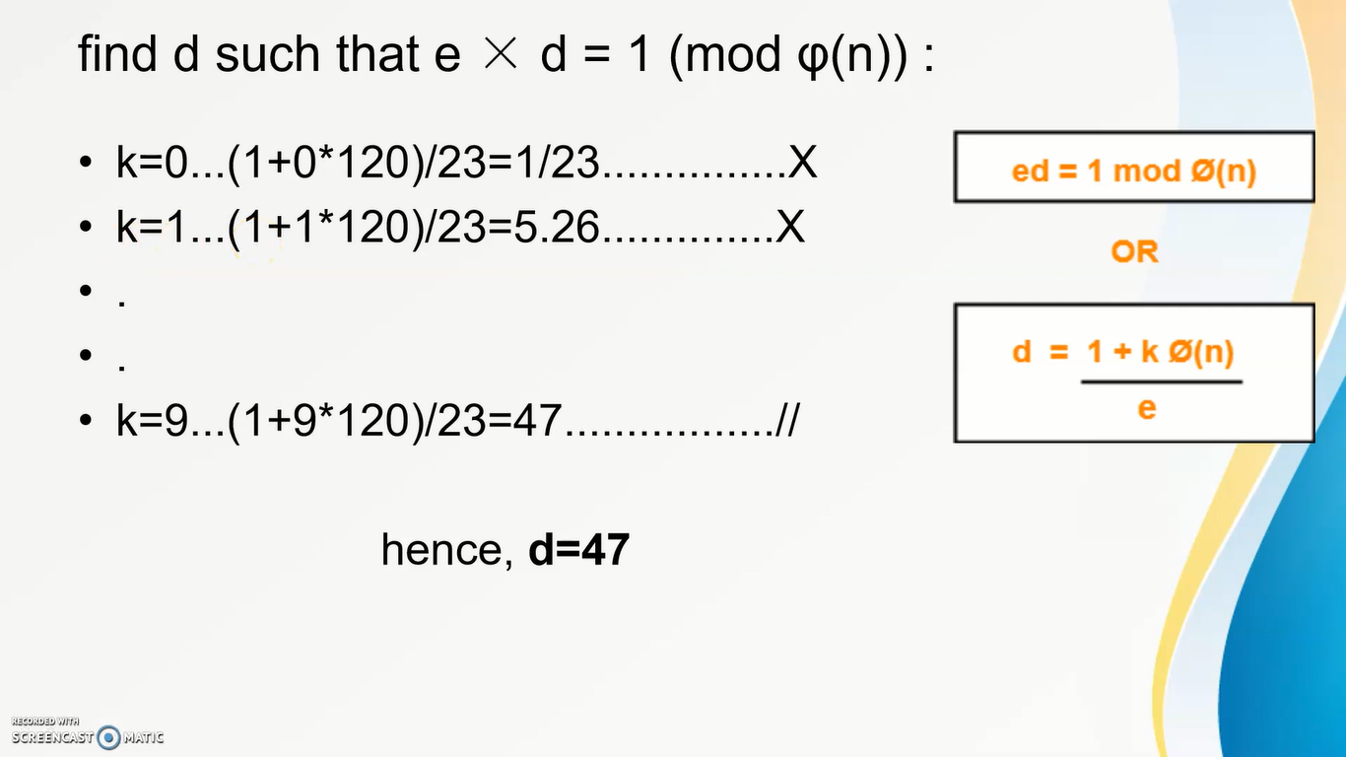
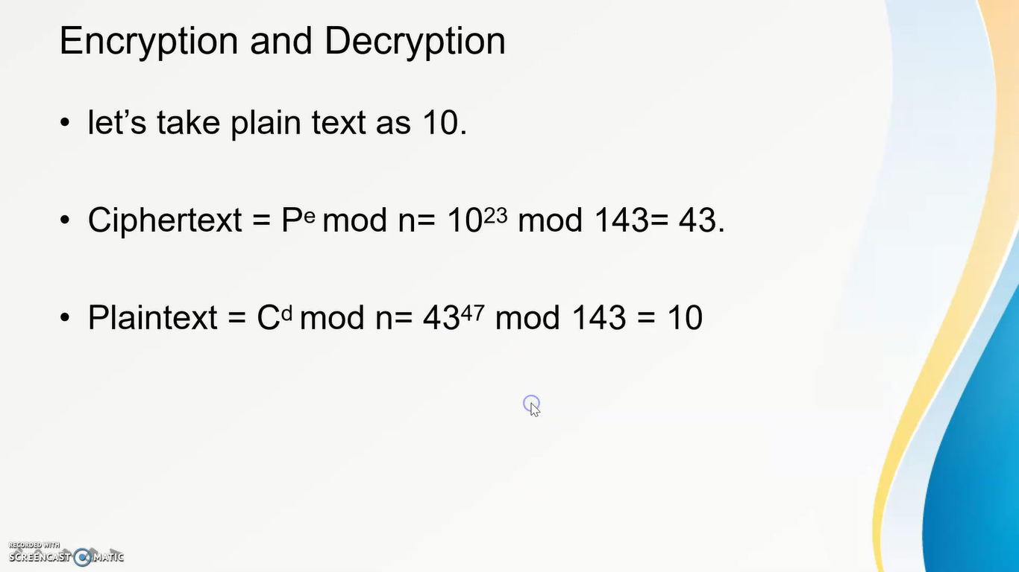
Math Example
21

Slide 22


Diffie-Hellman
Diffie-Hellman Algorithm was developed by Whitfield Diffie and Martin Hellman in 1976.
Diffie
Hellman
22
Why Diffie-Hellman?
Asymmetric Encryption of data requires transfer of cryptographic private key. The most challenging part in this type of encryption is the transfer of the encryption key from sender to receiver without anyone intercepting this key in between. This transfer or rather generation on same cryptographic keys at both sides secretively was made possible by the Diffie-Hellman algorithm.

Slide 23
Discrete Logarithm
Diffie-Hellman
Easy
(3)² mod 17 9
(3)? mod 17 9
Darth
Difficult
6
12
23
(6)¹² mod 17 = ?
How is it in Diffie-Hellman?
(12)⁶ mod 17 = ?
P=17
G=3
P=17
G=3
Bob
12
10
10
Alice
6
Private Key= 15
Private Key= 13
(3)¹⁵ mod 17 = 6
(3)¹³ mod 17 = 12
(12)¹⁵ mod 17 = 10
(6)¹³ mod 17 = 10

Slide 24
Procedures of Diffie -Hellman
Assuming a prime number & it’s primitive root
Assume a prime number q
24
Select ⍺, primitive root of q
⍺ < q
Step 1:
⍺ is a primitive root of q if:
Step 2:
⍺ mod q, ⍺² mod q, ⍺³ mod q………. ⍺^{q-1} mod q
Step 3:
1,2,3,........... q-1

Slide 25


Procedures of Diffie -Hellman
Finding private key & public of sender & receiver
25
Step 1:
Assume X_{A} (Private key of user A)
Assume X_{B} (Private key of user B)
Step 2:
X_{A} < q
X_{B} < q
Now calculate Public key, Y_{B}
Now calculate Public key, Y_{A}
Step 3:
Y_{A} = ⍺^{Xa} mod q
{ X_{A ,}Y_{A}}
Y_{B} = ⍺^{Xb} mod q
{ X_{B ,}Y_{B}}

Slide 26
Procedures of Diffie -Hellman
Finding private key & public of sender & receiver
26
Step 1:
X_{A ,}Y_{B,} q
X_{B ,}Y_{A,} q
Step 2:
Step 3:
K = (Y_{B})^{Xa} mod q
K = (Y_{A})^{Xb} mod q

Slide 27
Math example of Diffie -Hellman
Assuming a prime number & it’s primitive root
Power
Assume a prime number q = 11
 | 1 | 2 | 3 | 4 | 5 | 6 | 7 | 8 | 9 | 10
1 | 1 | 1 | 1 | 1 | 1 | 1 | 1 | 1 | 1 | 1
2 | 2 | 4 | 8 | 5 | 10 | 9 | 7 | 3 | 6 | 1
3 | 3 | 9 | 5 | 4 | 1 | 3 | 9 | 5 | 4 | 1
4 | - | - | - | - | - | - | - | - | - | -
5 | - | - | - | - | - | - | - | - | - | -
6 | - | - | - | - | - | - | - | - | - | -
7 | - | - | - | - | - | - | - | - | - | -
8 | - | - | - | - | - | - | - | - | - | -
9 | - | - | - | - | - | - | - | - | - | -
10 | - | - | - | - | - | - | - | - | - | -
27
Select ⍺, primitive root of q
⍺ < q
Step 1:
Number
⍺ is a primitive root of 11 if:
Step 2:
⍺ mod 11, ⍺² mod 11, ⍺³ mod 11………. ⍺¹¹⁻¹ mod 11
Step 3:
1,2,3,........... q-1
1,2,3,4,5,........10
⍺ = 2

Slide 28
Math example of Diffie -Hellman
Finding private key & public of sender & receiver
28
Step 1:
Assume X_{A} (Private key of user A) = 8
Assume X_{B} (Private key of user B) = 4
X_{A} < q
X_{B} < q
Step 2:
Now calculate Public key, Y_{A}
Now calculate Public key, Y_{B}
Y_{A} = ⍺^{Xa} mod q
= 2⁸ mod 11
= 3
Y_{b} = ⍺^{Xb} mod q
= 2⁴ mod 11
= 5
Step 3:

Slide 29
Procedures of Diffie -Hellman
Finding private key & public of sender & receiver
29
Step 1:
X_{A ,}Y_{B,} q = {8,5,11}
X_{B ,}Y_{A,} q = {4,3,11}
Step 2:
K = (Y_{B})^{Xa} mod q
= (5)⁸ mod 11
= 4
K = (Y_{A})^{Xb} mod q
= (3)⁴ mod 11
= 4
Step 3:

Slide 30
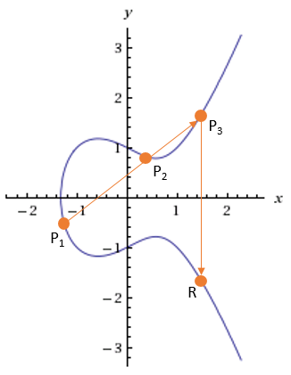
Elliptic Curve Cryptography
Elliptic Curve Cryptography (ECC) is a key-based technique for encrypting data. ECC focuses on pairs of public and private keys for encryption and decryption.
Elliptic curve are not ellipses. Elliptic curves are described by cubic equations.
30
y² = x³ + ax + b
∞
ECC key size of 256- bit is equivalent to a 3072-bit RSA key.
n

Slide 31
Procedures of ECC Diffie-Hellman
Step:
1
Global public elements and Key generation
Global public elements:
E_{q}(a,b) Elliptic curve with parameters a, b & q (prime number)
G Point in the elliptic curve
31
User A key generation:
Select private key n_{A}
Calculate public key P_{A}
User B key generation:
Select private key n_{B}
Calculate public key P_{B}
n_{A}< n
n_{B}< n
P_{A} = n_{A} x G
P_{B} = n_{B} x G
Calculation of secret key by User A,
K = n_{A} x P_{B}
Calculation of secret key by User B,
K = n_{B} x P_{A}

Slide 32
Procedures of ECC Diffie-Hellman
Step:
2
ECC Encryption
Let the message be M
First encode this message M into a point on elliptic curve. Let this point be P_{M}
For encryption, choose a random positive integer K
The cipher point will be,
C_{M} = { KG , P_{M} + K P_{B} }
This point will be sent to the receiver.
32

Slide 33
Procedures of ECC Diffie-Hellman
Step:
3
ECC Decryption
For decryption, multiply x-coordinate with receiver’s private key
KG × n_{B}
Then subtract ( KG × n_{B} ) from y-coordinate of cipher point,
{ P_{M} + K P_{B} - ( KG × n_{B} ) }
= { P_{M} + K P_{B} - KP_{B} }
= P_{M}
So the receiver gets the same point.
C_{M} = { KG , P_{M} + K P_{B} }
33
P_{B} = n_{B} x G
(Public key of User B)

Slide 34
Math example of ECC Diffie-Hellman
Step:
1
Global public elements and Key generation
Global public elements:
Let us consider,
E₂₅₇(0,-4) Elliptic curve with parameters a = 0, b = -4 & q = 257 (prime number)
G (2,2) Point in the elliptic curve
34
User A key generation:
Select private key n_{A}
Calculate public key P_{A}
User B key generation:
Select private key n_{B}= 101
Calculate public key P_{B}
_{= 100 (2,2)}
_{= (197,167)}
n_{A}< n
n_{B}< n
P_{A} = n_{A} x G
P_{B} = n_{B} x G
Calculation of secret key by User A,
K = n_{A} x P_{B}

Slide 35
Math example of ECC Diffie-Hellman
Step:
2
ECC Encryption
Let the message be M
First encode this message M into a point on elliptic curve. Let this point be P_{M} = (112,26)
For encryption, choose a random positive integer K = 41
The cipher point will be,
C_{M} = { KG , P_{M} + K P_{B} }
= [ 41(2,2), { (112,26) + 41(197,167) } ]
= (136,128), (246,174)
This point will be sent to the receiver.
35

Slide 36
Math example of ECC Diffie-Hellman
Step:
3
ECC Decryption
For decryption, multiply x-coordinate with receiver’s secret key
KG × n_{B}
= (136,128), (246,174)
Then subtract ( KG × n_{B} ) from y-coordinate of cipher point,
{ P_{M} + K P_{B} - ( KG × n_{B} ) }
= (246,174) - 101(136,128)
= (246,174) - (68,84)
= (112,26)
= P_{M} So the receiver gets the same point.
C_{M} = { KG , P_{M} + K P_{B} }
36
n_{B} = 101
(Private key of User B)

Slide 37
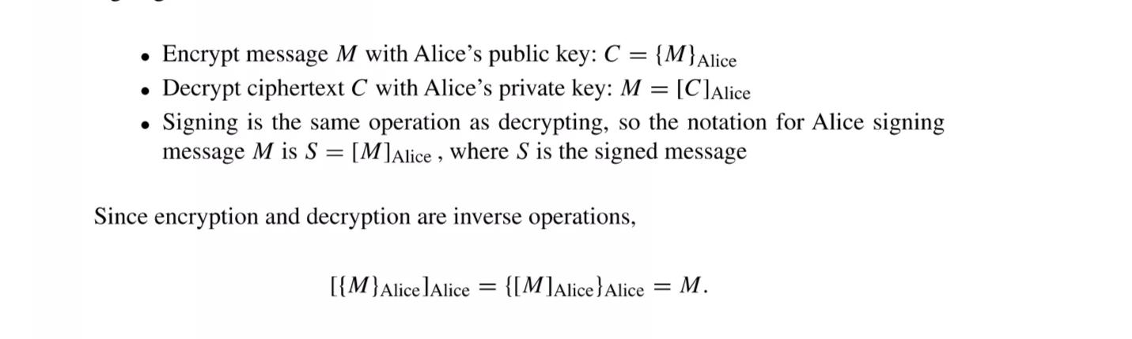
Public Key Notation
The public key is only used to encrypt data and to decrypt the data.
37

Slide 38
Public Key Infrastructure
Public key Infrastructure is a set of hardware,software,people,policies, procedure needed to create, manage, store,distribute and revoke digital certificates based on asymmetric cryptography
Purpose of Public Key Infrastructure (PKI):
The purpose for developing a PKI is to enable secure, convenient and efficient obtain public keys.
PKIX:
PUblic key infrastructure X.509 is called as PKIX.
38

Slide 39
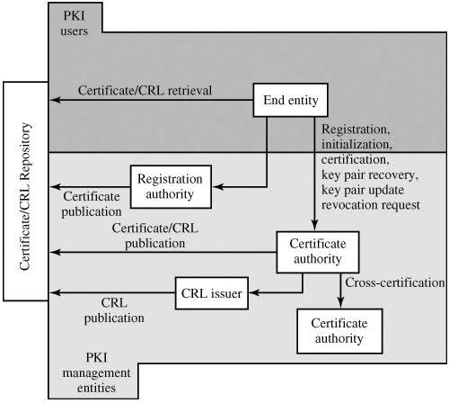
PKIX Elements
1.End entity
2.Certificate Authority
3.Registration Authority
4.CRL’s issuers
5.Repository
39

Slide 40
PKIX Management Function
1.Registration
2.Initialization
3.Certification
4.Key pair Recovery
5.Key Pair update
6. Revocation request
7.Cross Certification
40

Slide 41
PKI Management Protocols
The PKI working group has defines two alternative management protocols.
1.RFC 2510 defines the certificate management protocols(CMP).
PKI service allows a CMP Client to communicate with it to request revoke,suspend and resume certificate.
2.RFC 2797 defines certificate management message over CMS.
Where CMS refers to RFC 2630,and cryptographic message syntax(CMS).
CMS can encrypt,decrypt,sign and verify, compress and decompress CMS documents.
41

Slide 42
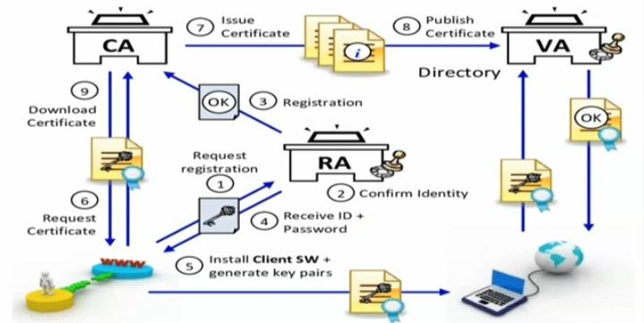
Working of Public Key Infrastructure (PKI)
42

Slide 43
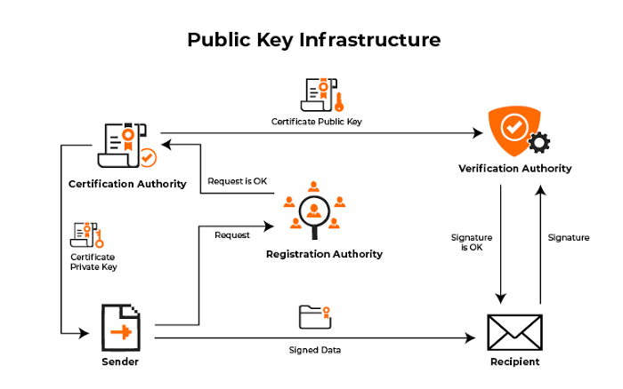
Real time example of PKI
43

Slide 44
Thank
You
44

